Slide 1
Analyzing Appraisals:
A data-driven approach to Collin County Real Estate
Aliyah Sabir
ADTA 5940

Slide 2
Research Questions/Topics
Property type value
Value change over time
Residential, commercial, land, and business personal property (equipment, external structures, etc.)
Year over year change across property types in the top 5 cities in the county
Value prediction
Non-structural attributes
Which model most accurately products market value?
How do amenities and non-structural attributes impact property value?

Slide 3
Technical Terms
Appraisal | Evaluating the value of a property
Absorption | The rate at which property is bought
Protest | Appealing an appraisal
Efficiency | The value of the usable square footage of a building
Notice year | “Next year”, projected value

Slide 4
Literature Review
Key Findings
Larger homes often sell at discount (~11%), smaller homes at premium (~4.7%)
Spatial autocorrelation is a real market mechanism affecting property values
Greenway proximity can add 5.7-12.2% to property value
Walkability can increase property value by up to 6%
Need for standardized evaluation metrics for advanced property valuation prediction models
Institutional reform needed for equity
Traditional vs. modern valuation methods
Challenges
Technical: Spatial autocorrelation, multicollinearity, heteroskedasticity
Structural: understaffing, poor training, no state mandate
Value drivers
Structural
Non-structural
Locational
Spatial dependence (diffusion of renovation or lack thereof)

Slide 5
Methodology
Property types
Value over time
EDA with barplots to explore
Overall property value & value per square foot
Supply and demand
Efficiency, land value contribution, and market share
Barplots to depict year over year change and projected change over property types in top 5 cities in the county
Geographic heatmaps for previous, current, and notice valuation years
Non-structural attrs.
Value prediction
XGBoost vs. Multilayer Perceptron*
Target variable: noticeValMarket
Evaluation: accuracy, RMSE, R²
OLS regression to find predictors of amenity or non-structural value
*Bayesian Regularization model with back propagation, 2 hidden layers, and Adam optimization

Slide 6
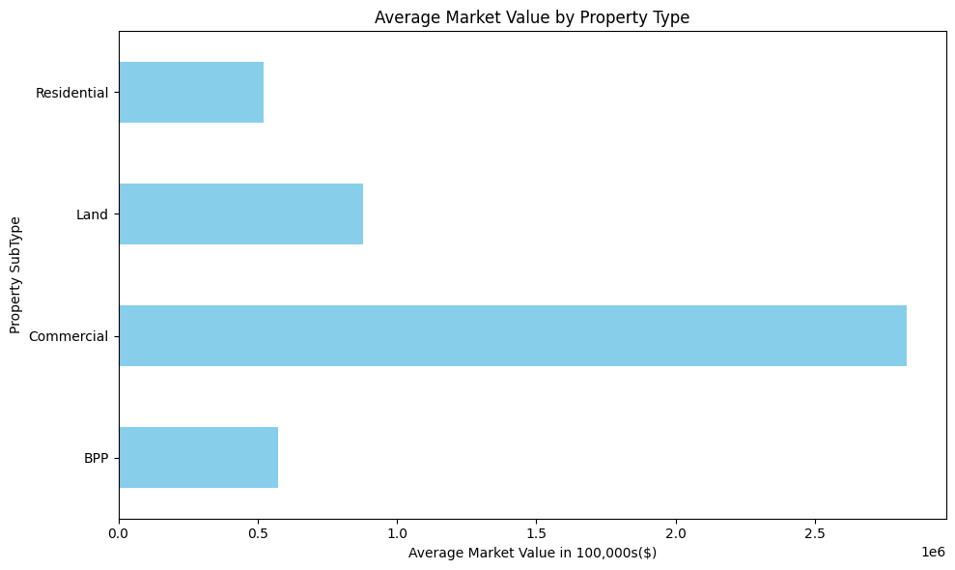
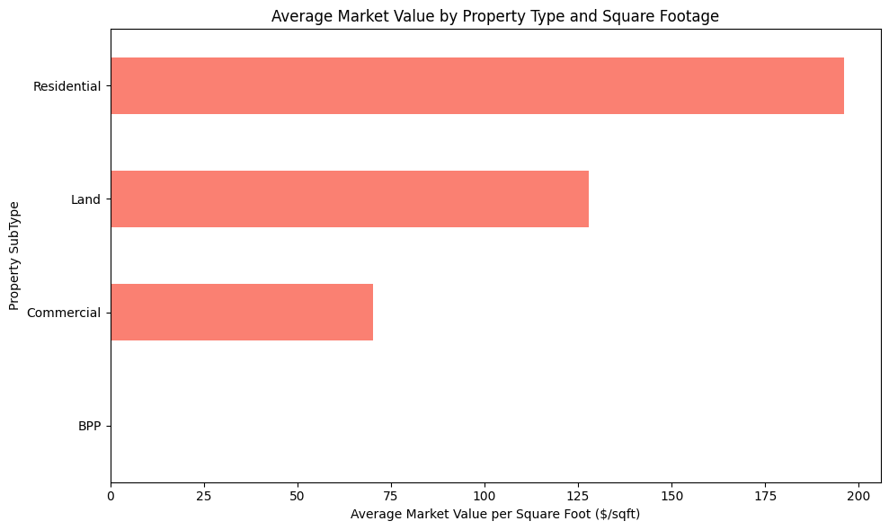
Results- Q1

Slide 7
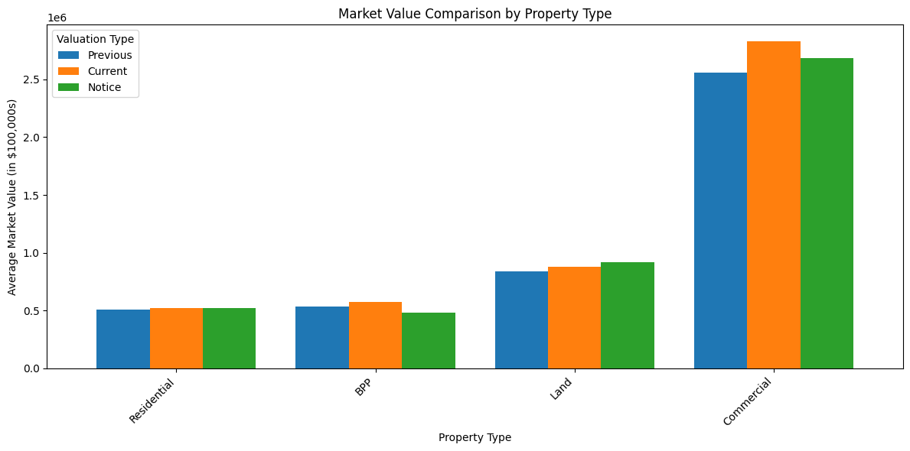
Results

Slide 8
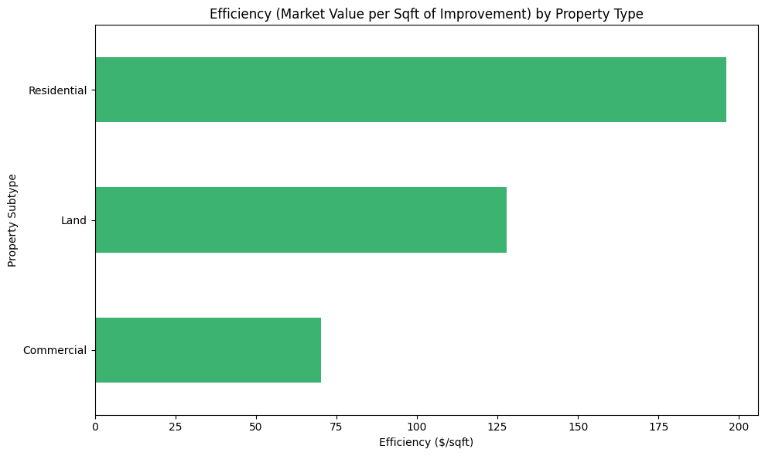
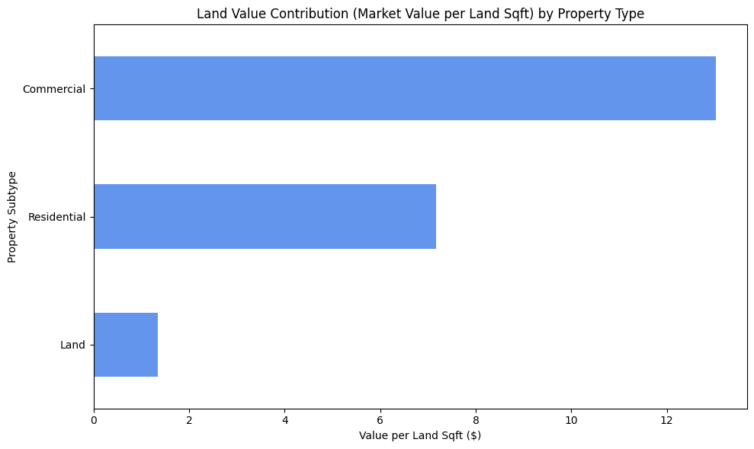

Slide 9
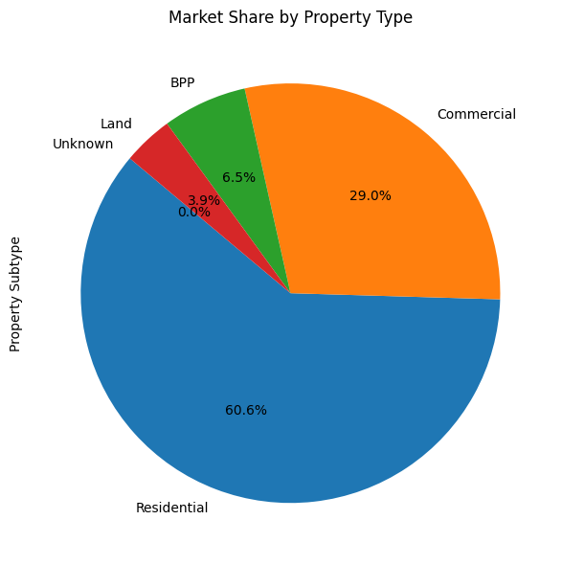
MARKET SHARE

Slide 10
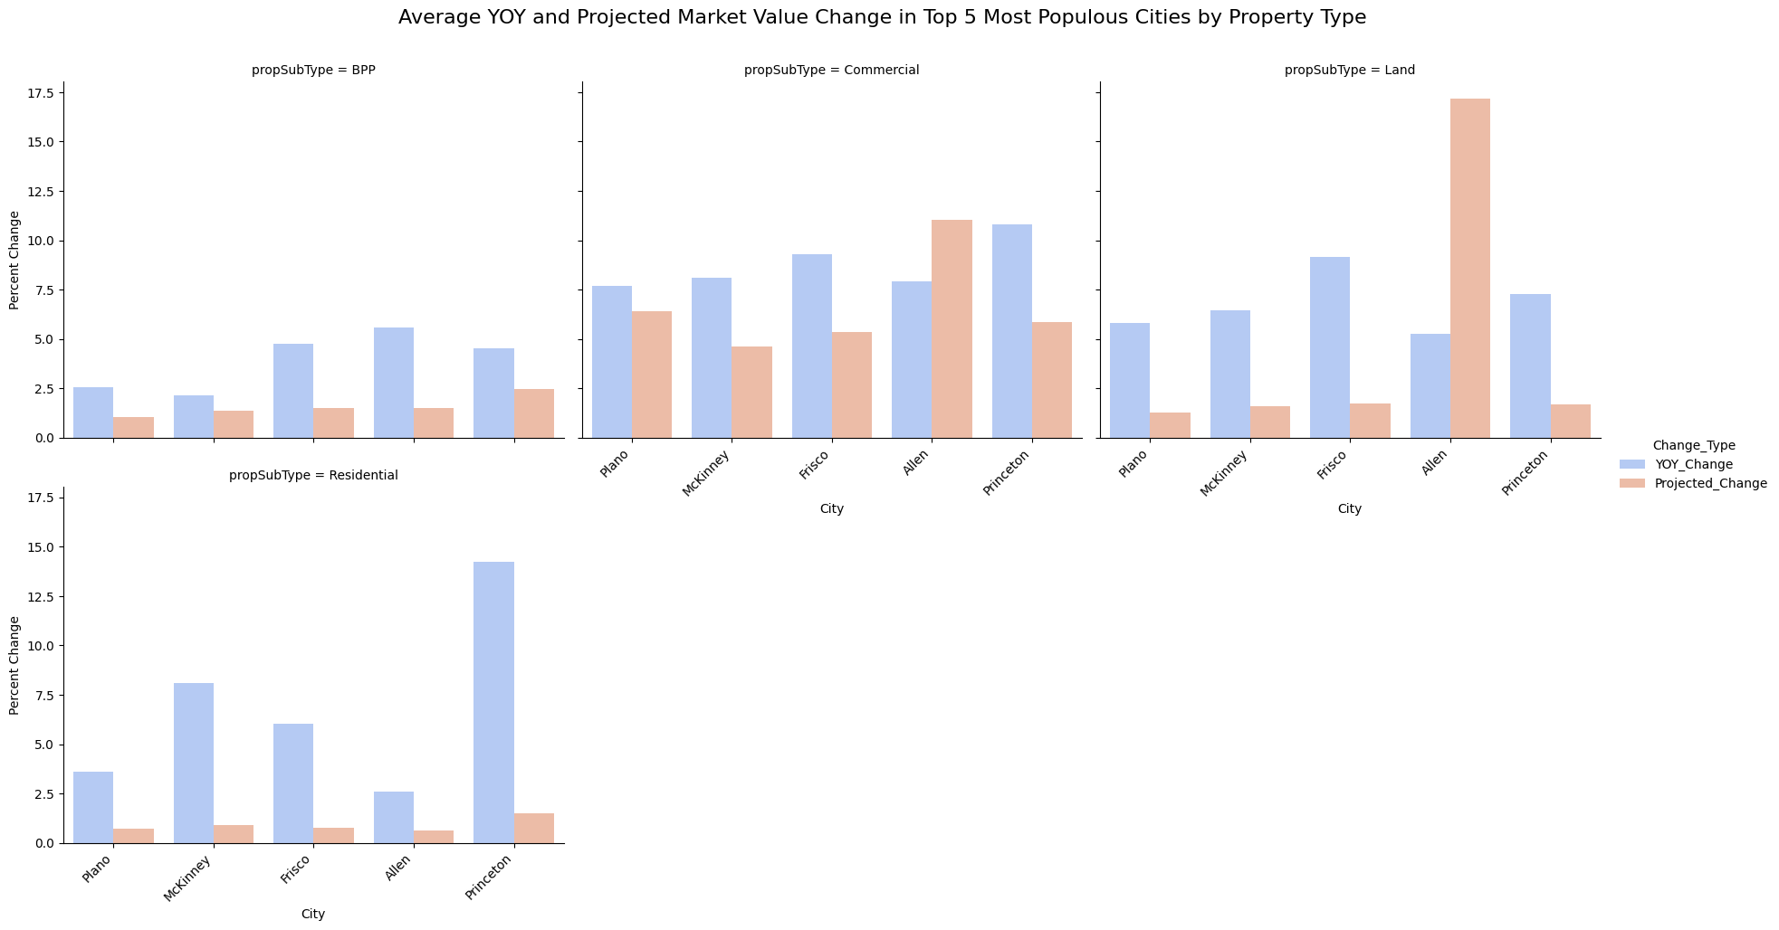
Results- Q2

Slide 11
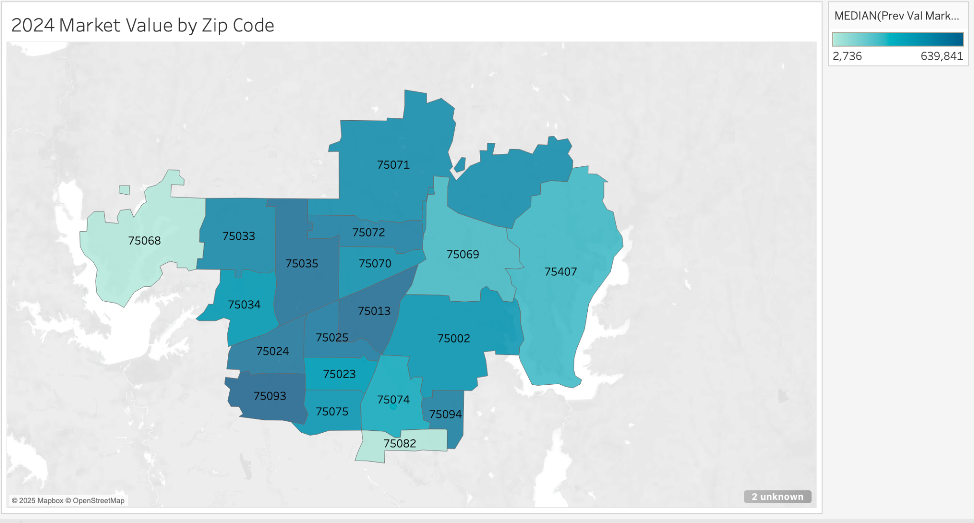
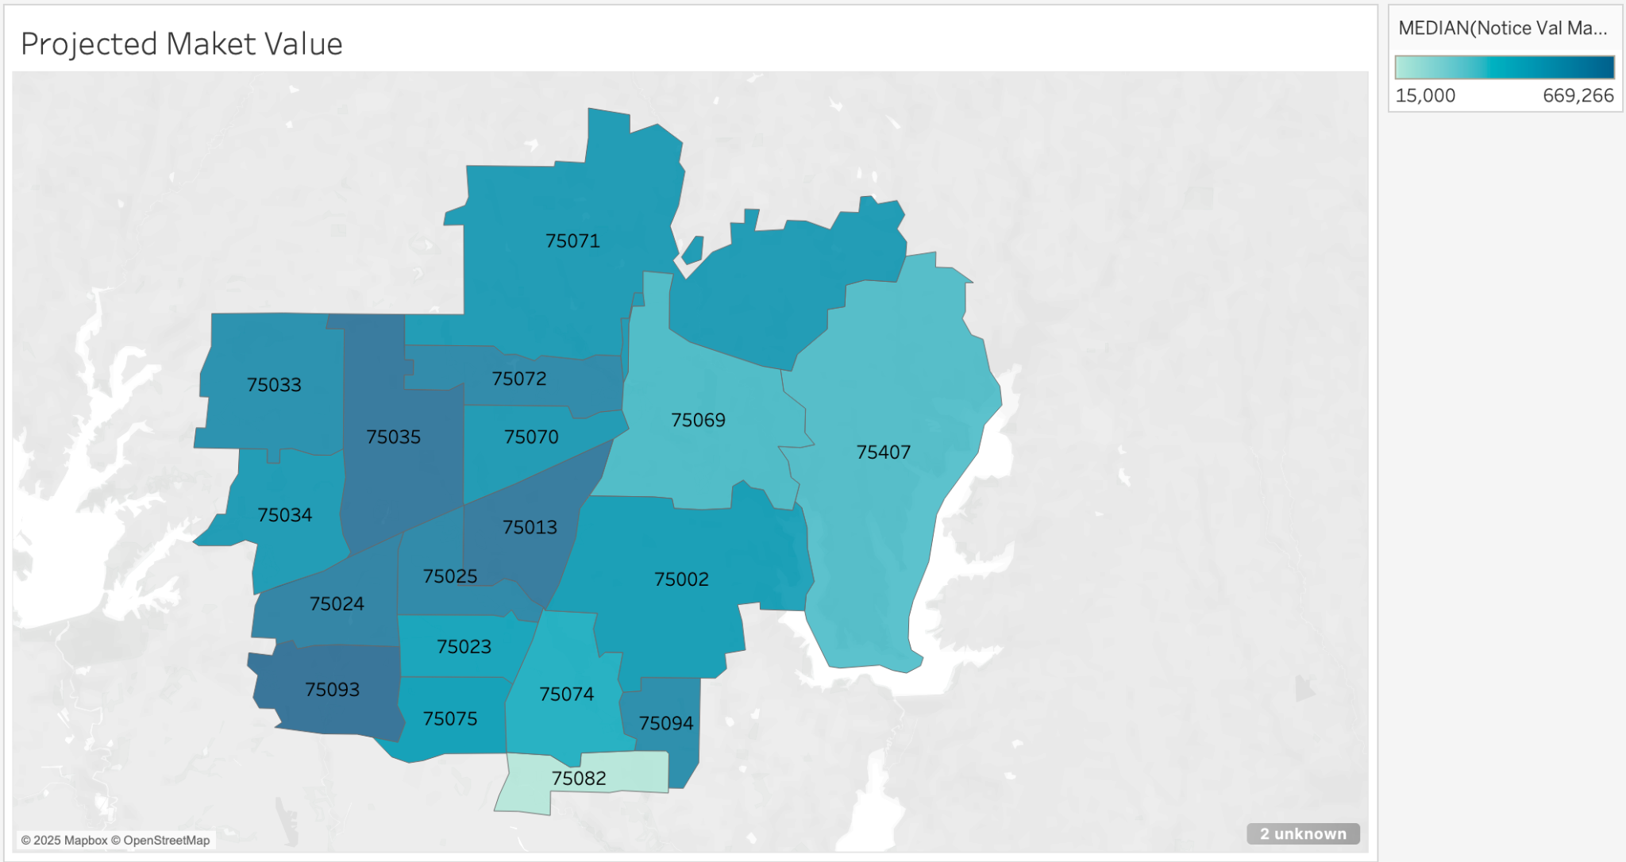
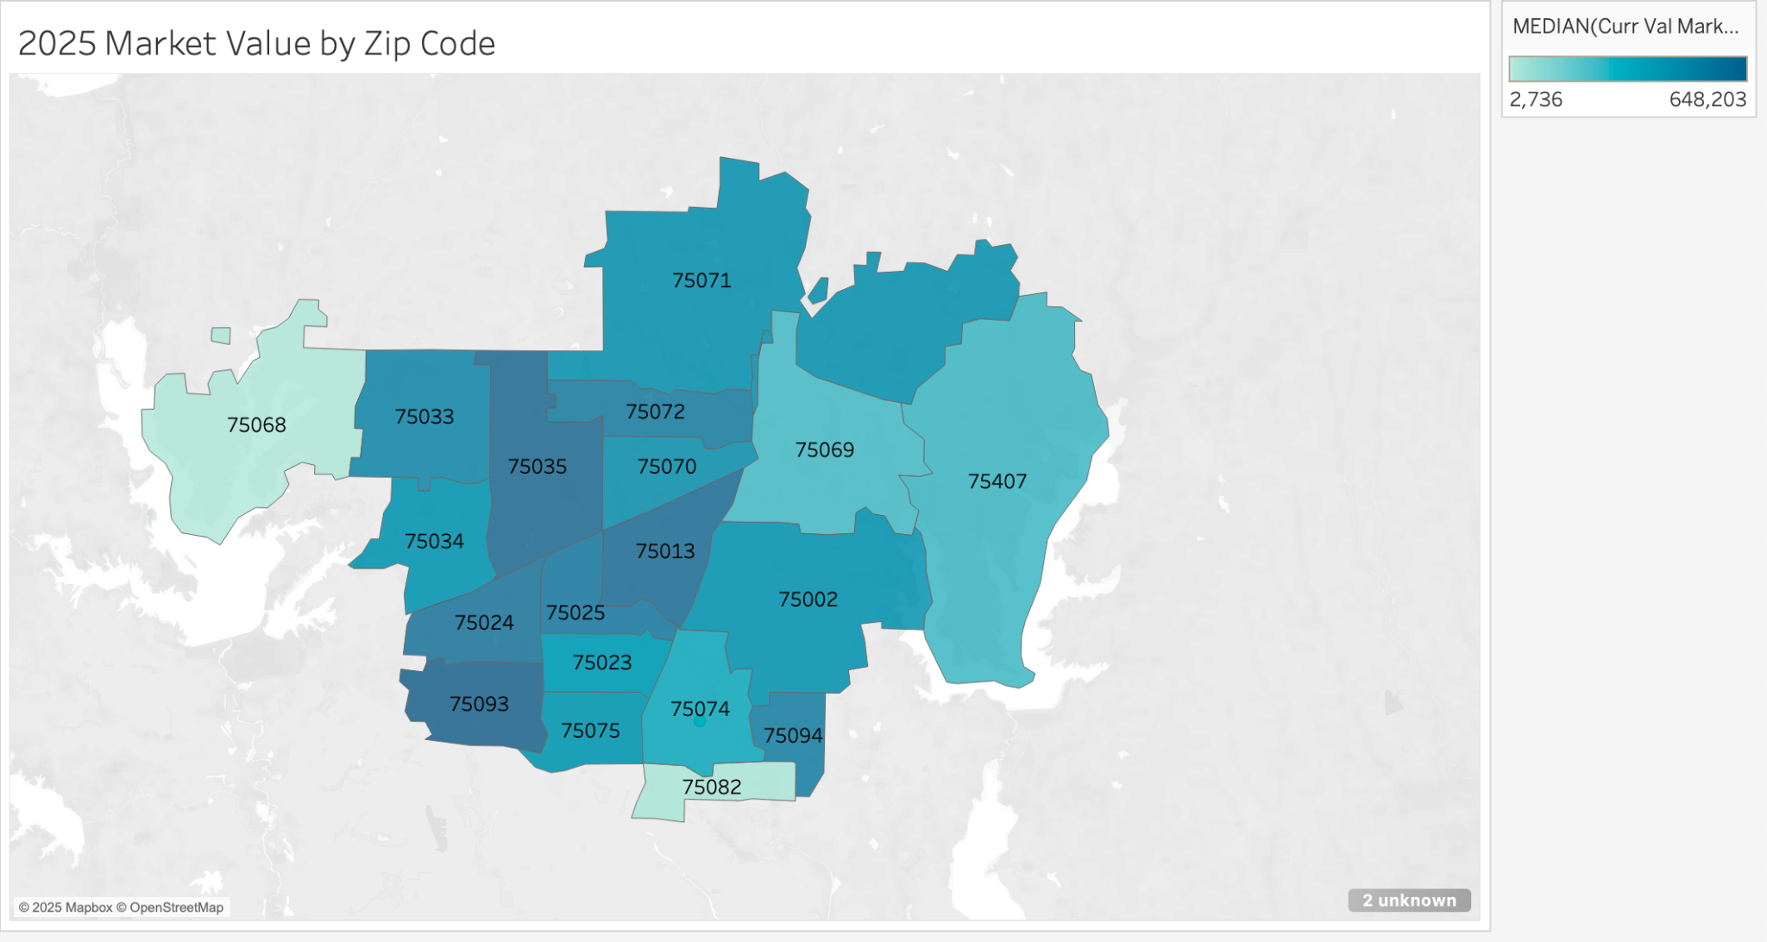
Results

Slide 12
Results- Q3 and Q4
OLS Regression Results
==========================================================================
Dep. Variable: noticeValMarket
R-squared: 0.912
Model: OLS
Adj. R-squared: 0.912
Method: Least Squares
F-statistic: 6.450e+05
Date: Sat, 19 Jul 2025
Prob (F-statistic): 0.00
Time: 02:41:47
Log-Likelihood: -4.8817e+06
No. Observations: 371950
AIC: 9.763e+06
Df Residuals: 371943
BIC: 9.764e+06
Df Model: 6
Covariance Type: nonrobust
Valuation price prediction
XGBoost vs Bayesian Regularization neural network
Impact of non-structural attributes:
OLS regression
R²: 0.912
Principal Component Analysis
ecoGroupGBA: location-based appraisal zones were a significant predictor of notice market value

Slide 13
Discussion
Local dynamics, RQ 1&2
Highest average market value: commercial
Highest avg. value per sq. ft.: residential
Allen: highest YOY growth and projected change
Princeton: highest YOY change in commercial property
Frisco: Highest YOY change in land and residential property
Non-structural attributes, RQ 3&4
Location-based appraisal zones, spatial dependence confirmed
Residential properties have high efficiency and commercial properties have a higher per-square-foot value,

Slide 14
Recommendations and Conclusion
Economic implications
Cities are dependent on a small number of commercial taxpayers; need to ensure financial stability in unforeseen circumstances
Equity concerns of systematic undervaluation in areas negatively impacted by spatial dependence
Planning and Development
Urban planners can use spatial patterns to influence development
Appraisers can target high volume areas
Opportunity to improve building efficiency across property types, but should focus on commercial types
Updated design policies and construction regulations

Slide 15
THANKS
QUESTIONS?
AliyahSabir@my.unt.edu
Please keep this slide for attribution

Slide 16


